Slide 1
CLOUD COMPUTING PRACTICAL#02
OBJECTIVE: TO BECOME FAMILIAR WITH RMI OBJECT SERIALIZATION

Slide 2
REMOTE METHOD INVOCATION
RMI uses object serialization to marshal and unmarshal parameters and does not truncate types, supporting true object-oriented polymorphism.

Slide 3
SERIALIZATION
Serialization is the process of converting a set of object instances that contain references to each other into a linear stream of bytes, which can then be sent through a socket, stored to a file, or simply manipulated as a stream of data.
Serialization is the mechanism used by RMI to pass objects between JVMs, either as arguments in a method invocation from a client to a server or as return values from a method invocation.

Slide 4
NOW WE WILL SEE CODE FOR PASSING OBJECTS THROUGH RMI
Our scenario will have a server sharing an object via RMI and a client calling the shared instance.

Slide 5
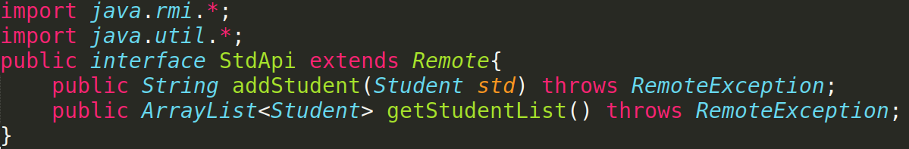
Interface

Slide 6
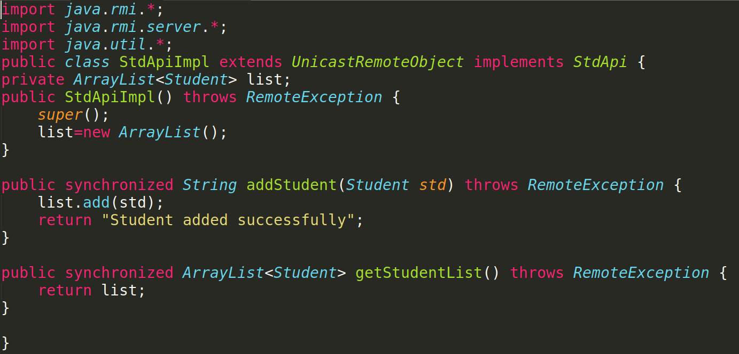
Remote Object Class

Slide 7
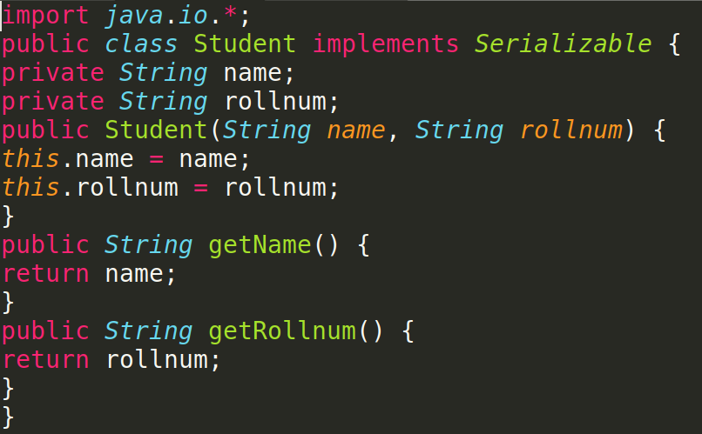
Serializable Class

Slide 8
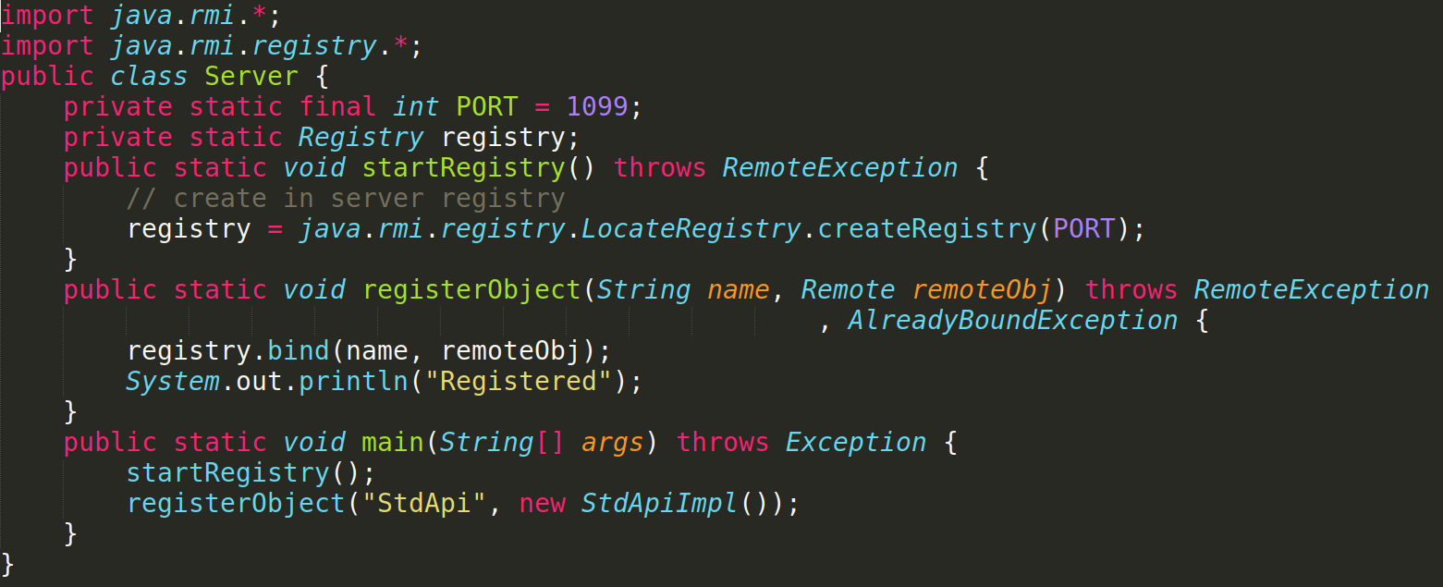
Server Class

Slide 9
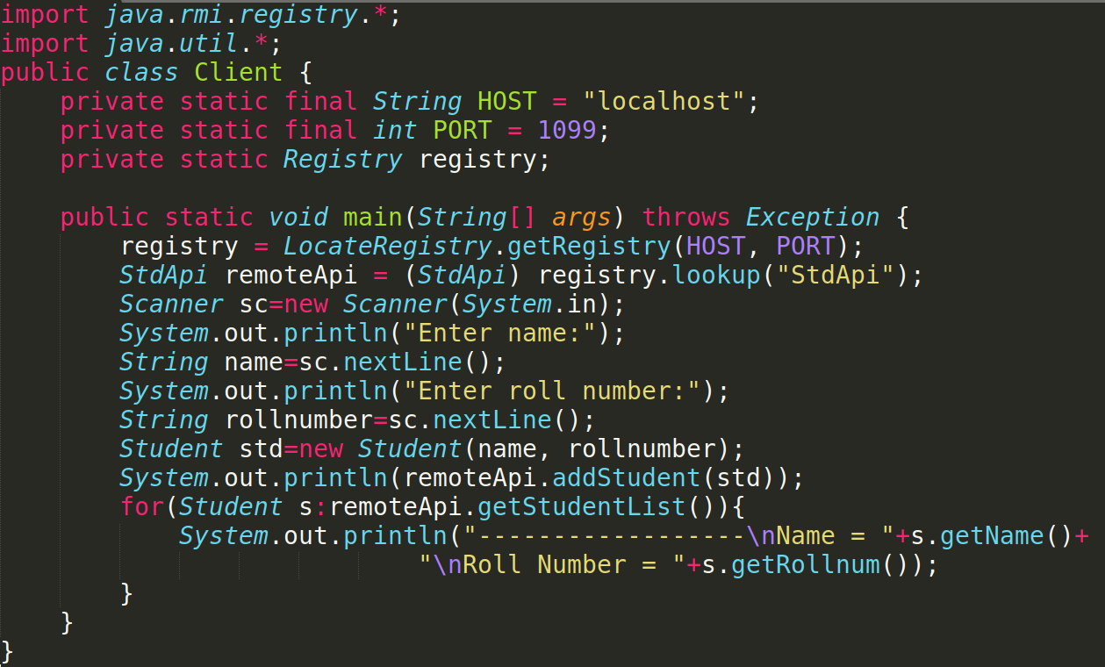
Client Class

Slide 10
TASK:
Develop any simple application to demonstrate object passing in RMI. (Expl: Make a class of your own and use its objects as arguments and return types for RMI)

